Slide 1
Diodes

Slide 2
Semiconductors
Semiconductors
A semiconductor is an element with electrical properties between conductor and insulator.
Example Silicon,Germanium.
Intrinsic Semiconductors
An Intrinsic semiconductor is a pure semiconductor.
Extrinsic semiconductor
One way to increase conductivity of a semiconductor is by doping. This means adding impurity atoms to an intrinsic crystal to alter its electrical conductivity. A doped semiconductor is called an extrinsic semiconductor.
A semiconductor can be doped to have an excess of free electrons or an excess of holes. Based on this, there are two types of doped semiconductors.
N-Type Semiconductor
P-Type Semiconductor

Slide 3
N-Type Semiconductor
Fig. 1 Antimony impurity n-type material.
The n-type is created by introducing the impurity elements that have five
valence electrons (Pentavalent), such as antimony, arsenic, and phosphorus.
Inserted impurity atom has donated a free electron to the structure.
Diffused impurities with five valence electrons are called donor atoms.
In an n-type material , electron is called the majority carrier and hole is the minority carrier.

Slide 4
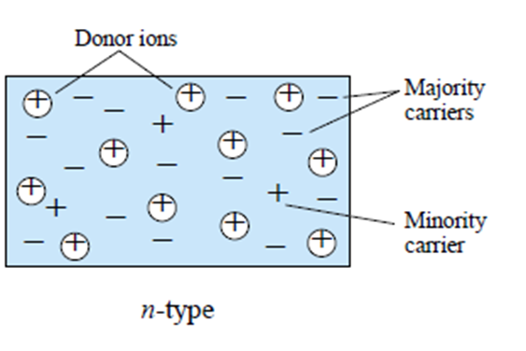
N-Type Semiconductor
Diffused impurities with five valence electrons are called donor atoms.
In an n-type material , electrons - majority carrier , hole - minority carrier

Slide 5
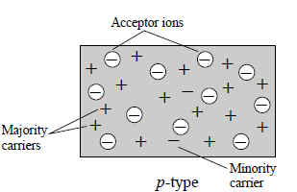
P-Type Semiconductor
The p-type material is formed by doping a pure germanium or silicon crystal with impurity atoms having three valence electrons. The elements most frequently used for this purpose are boron, gallium, and indium.
Boron impurity in P type material.
The diffused impurities with three valence electrons are called acceptor atoms.
In a p-type material the hole is the majority carrier and the electron is the minority carrier.

Slide 6
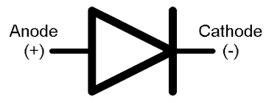
Semiconductor Diode
The PN junction diode is formed by joining n- and p-type materials together
Diode symbol
Since the diode is a two-terminal device, the application of a voltage across its
terminals leaves three possibilities:
No bias (VD = 0 V),
Forward bias ,
Reverse bias .

Slide 7
No bias (VD = 0 V)
In pn-junction formation, the free electrons near the junction in the n region begin to diffuse across the junction into the p region where they combine with holes near the junction. The result is that n region loses free electrons as they diffuse into the junction. This creates a layer of positive charges (pentavalent or Donor ions) near the junction.
As the electrons move across the junction, the p region loses holes as the electrons and holes combine. The result is that there is a layer of negative charges (trivalent or acceptor ions) near the junction.
These two layers of positive and negative charges form the depletion region or depletion layer. The term depletion is due to the fact that near the junction, the region is depleted of charge carries (free electrons and holes) due to diffusion across the junction.

Slide 8
No bias (VD = 0 V),
There exists a potential difference across the depletion layer and is called barrier potential (V0).
The barrier potential of a pn junction depends upon the type of semiconductor material used.
barrier potential :
For silicon, V0 = 0.7 V ;
For germanium, V0 = 0.3 V

Slide 9
Forward bias
A forward-bias is established by applying the positive potential to the p-type material and the negative potential to the n-type material as shown in given Figure.
The forward-bias potential VD will pressure electrons in the n-type material and holes in the p-type material to recombine with the ions near the boundary and reduce the width of the depletion region
The resulting minority-carrier flow of electrons from the p-type material to the n-type material (and of holes from the n-type material to the p-type material) has not changed in magnitude.

Slide 10
VI Characteristics
As the applied bias increases in magnitude the depletion region will continue to decrease in width until a flood of electrons can pass through the junction resulting in an exponential rise in current as shown in the forward-bias region of the characteristics.
Cut in voltage- It is the forward voltage at which the current through the junction starts to increase rapidly.

Slide 11
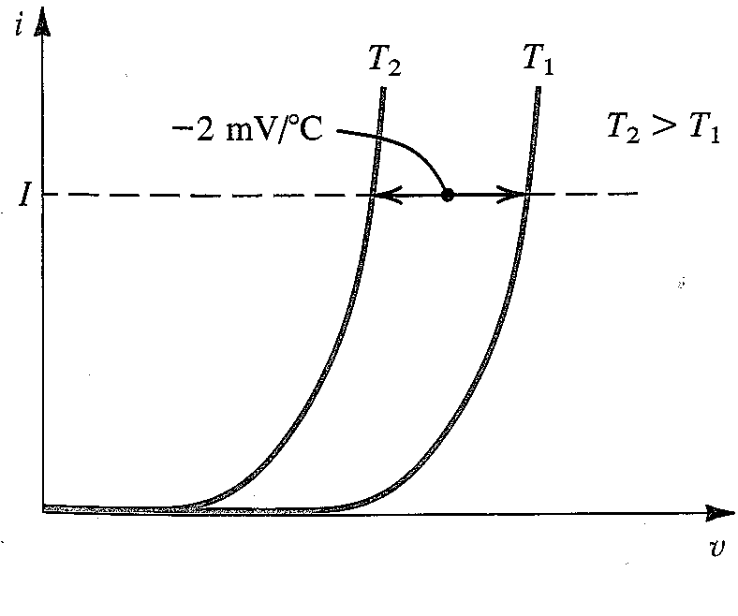
Temperature effect
When the temperature increases, the cut in voltage decreases. At a constant current ,the voltage drop decreases by approximately 2 m V for every 1°C increase in temperature.
The reverse saturation current Is ---- double in magnitude for
every 10°C increase in temperature.

Slide 12
Forward bias
Current is a function of the external voltage applied to the junction. The theoretical equation for the current
……………….[1]
I_{S} is the saturation current, η is the emission coefficient or idealty factor, and V_{T} = kT /q is the thermal voltage. Where k is the boltzman constant ( 1.38x10 ⁻²³ J/K) and q is the charge of electron.
At T = 300 K, the thermal voltage has the value V_{T} = 0.0259V.
Discrete silicon diodes that are not fabricated as part of an integrated circuit have the value η =2. Silicon diodes that are fabricated as part of an integrated circuit have the value η =1.

Slide 13
Forward bias
In the forward bias characteristic curve ,the plot of an exponential curve increases so rapidly ,that it appears to approach an almost vertical line at v = 0.7 V . Let us investigate the change in voltage with current in this region.
For i >> IS , Eq. (1) can be approximated by

Slide 14

Example
For an example , let i2 = 10 i1. At room temperature, we have
Δv = ηVT ln (10) =0.06η.
It follows that the change in voltage necessary to change the current by a decade is
Δv =.06 V for η = 1
Δv = 0.12V for η = 2.
Thus a small change in voltage causes a large change in current.

Slide 15
Reverse bias
In Reverse bias, the external potential of V volts is applied across the
p-n junction such that the positive terminal is connected to the n-type material and the negative terminal is connected to the p-type material as shown in Figure. The number of positive ions in the depletion region of the n-type material will increase due to the large number of free electrons drawn to the positive potential of the applied voltage.

Slide 16
Reverse Bias
The number of negative ions will increase in the p-type material. The net effect, is a widening of the depletion region. This widening of the depletion region will establish barrier for the majority carriers to overcome, effectively reducing the majority carrier flow to zero.
The current that exists under reverse-bias conditions is called the reverse saturation current and is represented by Is, due to the minority carriers.
Its value is typically in the nanoampere range for silicon devices and in the microampere range for germanium.

Slide 17
Diode models
we usually replace a device or system by its equivalent circuit. An equivalent circuit of a device (e.g. crystal diode, transistor etc.) is a combination of electric elements, when connected in a circuit, acts exactly as does the device when connected in the same circuit.
Equivalent circuit of a diode
Ideal diode
Constant voltage drop model

Slide 18
Ideal diode
The diode conducts well in the forward direction and poorly in the reverse direction. Ideally, a diode acts like a perfect conductor (zero resistance) when forward Biased and like a perfect insulator (infinite resistance) when reverse biased
An ordinary switch has zero resistance when closed and infinite resistance when open. Therefore, an ideal diode acts like a switch that closes when forward biased and opens when reverse biased.
The Ideal diode model treats a forward-biased diode like a closed switch with a voltage drop of zero volts

Slide 19
Constant voltage drop model
Figure a shows a current versus voltage for Constant voltage drop model.
No current - until 0.7 V appear across the diode. When the voltage reaches 0.7 v the diode turns on, 0.7 V can appear across the diode.
Figure b shows the equivalent circuit for the Constant voltage drop model a silicon diode. The diode act as a switch in series with a barrier potential of 0.7 V.
If the voltage across the diode is greater than 0.7 V, the switch will close. On the other hand, if the voltage is less than 0.7 V, the switch will open. In this case, there is no current through the diode.

Slide 20
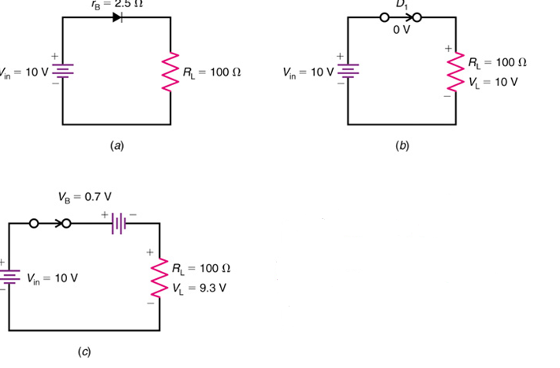
Diode models

Slide 21
Problem
Calculate the forward bias current of a Si diode when forward bias voltage of 0.4V is applied, the reverse saturation current is 1.17×10⁻⁹A and the thermal voltage is 25.2mV.
Solution
Equation for diode current I=I_{s}×(e^{(V/ηV}_{T}⁾-1)
where I_{s} = reverse saturation current η = ideality factor V_{T} = thermal voltage V = applied voltage Since in this question ideality factor is not mentioned it can be taken as one. I₀ = 1.17 x 10⁻⁹A, V_{T} = 0.0252V, η = 1, V = 0.4V Therefore, I= 1.17×10⁻⁹x e ^{0.4/0.025} -1 = 9.156mA

Slide 22
Diode parameters
Maximum power rating.
It is the maximum power that can be dissipated at the junction without damaging it..
Maximum forward current.
It is the highest instantaneous forward current that a pn junction can conduct without damage to the junction.
Peak inverse voltage.
It is the maximum reverse voltage that a diode can withstand without destroying the junction.

Slide 23
Diode parameters
Knee Voltage
In the forward region, the voltage at which the current starts to increase rapidly is called the knee voltage or Cut in voltage of the diode. The knee voltage equals the barrier potential
Vk= 0.7 (Si)
Vk= 0.3 (Ge)
Reverse current or leakage current.
It is the current that flows through a reverse biased diode. This current
is due to the minority carriers.

Slide 24
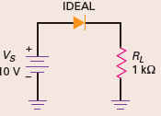
Problem
Use the ideal diode model to calculate the load voltage and load current in the circuit.
Since the diode is forward biased, it is equivalent to a closed switch. :
V_{s}= 10 V
With Ohm’s law, the load current is:
Lecture 29

Slide 25
Problem
Use Constant voltage drop model to calculate the load voltage and load current,
Solution
Since the diode is forward biased, it is equivalent to a battery of 0.7 V.
VL =10 V - 0.7 V =9.3 V
With Ohm’s law, the load current is:

Slide 26
Problem
For the series diode configuration given in the Figure, determine V_{D}, V_{R}, and I_{D}.(Constant voltage drop model)
The diode is in the “on” state,

Slide 27
Thank You

